Slide 1
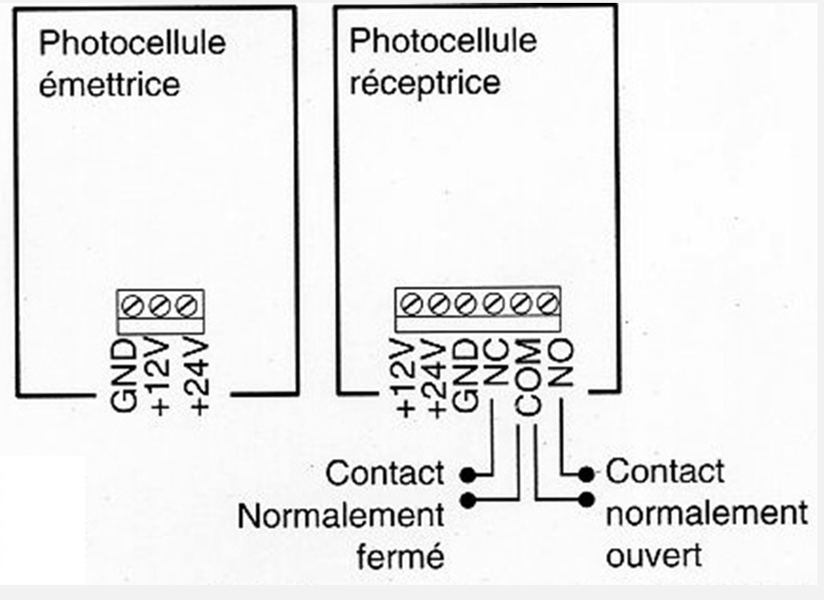
Branchement sur AXROLL
10 11 12 14 16
GND = 0V
COM = C

Slide 3
